Slide 1
PROBLEM STATEMENT
Due to the effect on covid 19 people find it hard to go to restaurants in a locality to buy food therefore a
system is created for interested managers of various restaurant managers to add the food they have
in-order for people to order and receive it at the comfort of their homes.

Slide 2
REQUIREMENTS
System requirement : The system has a portion for one to signup , login , logout, delete
food , add food, order food and pay bill either before or after delivery.
user requirement:
manager: A manager can signup , login, add food , add restaurant , delete food , edit food.
Customer : A customer can signup , login , logout , order food , make payment.

Slide 3
SOFTWARE PROCESS
AGILE PROCESS
Therefore changes can be made to the system at any time.

Slide 4
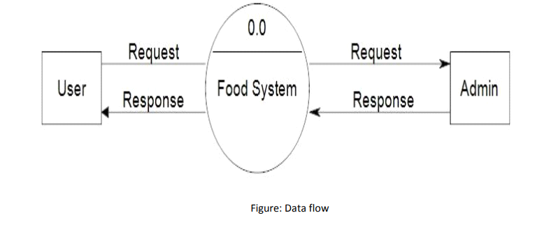
SOTFWARE MODEL Incremental model

Slide 5
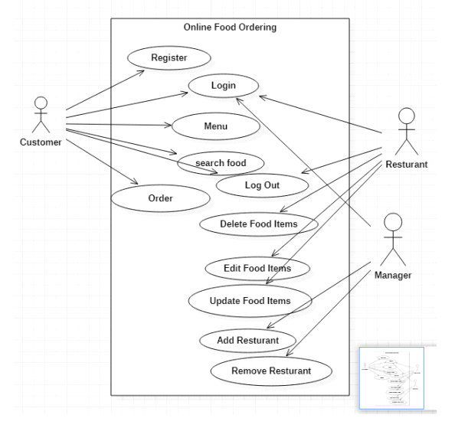
SYSTEM SOFTWARE ACHITECHTURE

Slide 6
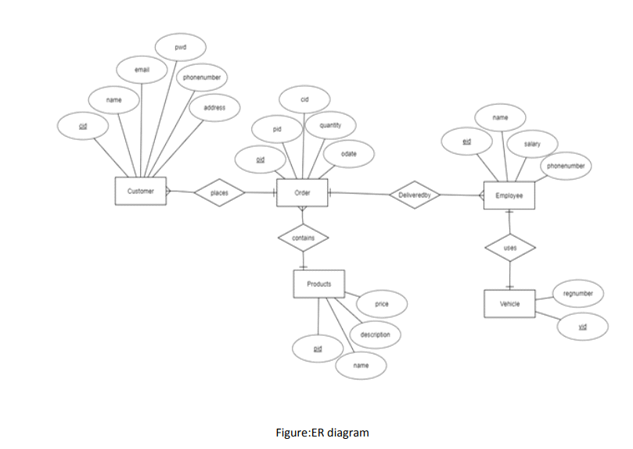
USE CASE DIAGRAM

Slide 7
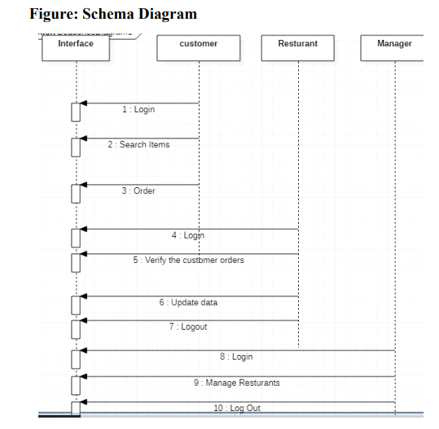

Slide 8
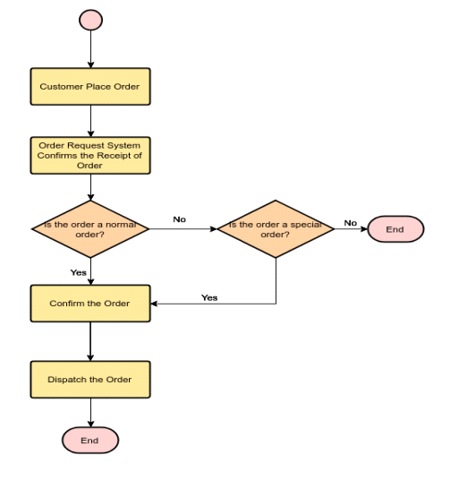
flow chart of Ecommerce

Slide 9
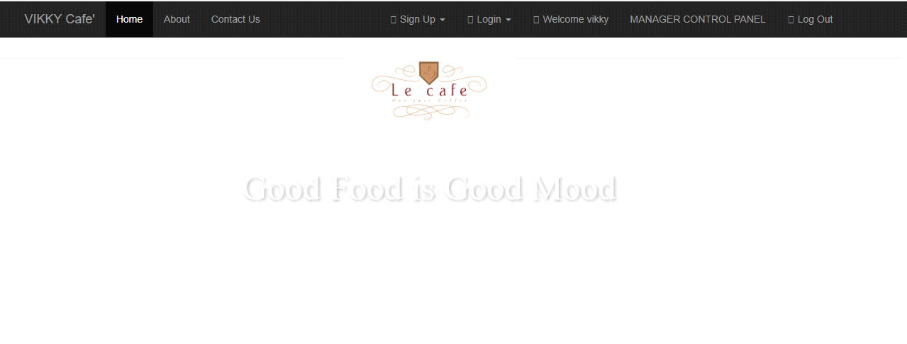
DESIGN AND IMPLEMENTATION

Slide 10
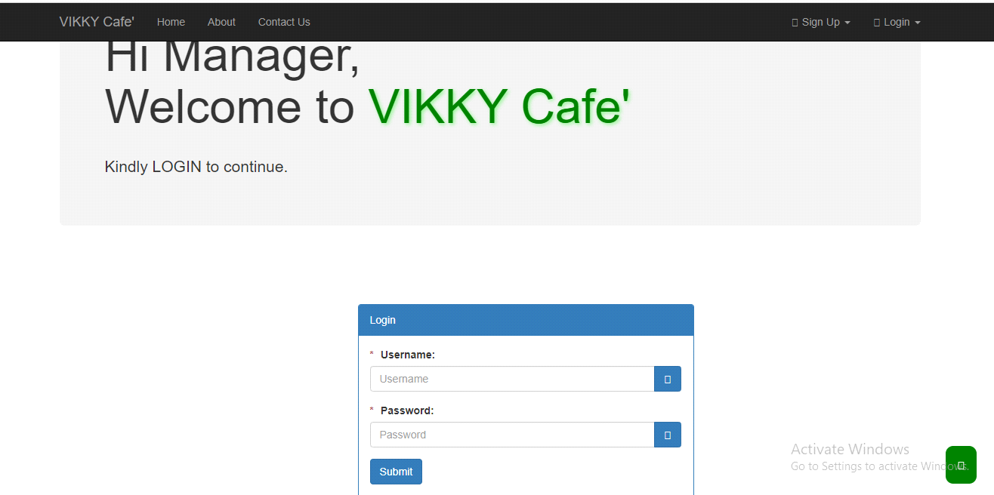
Continuation of design and implementation

Slide 11
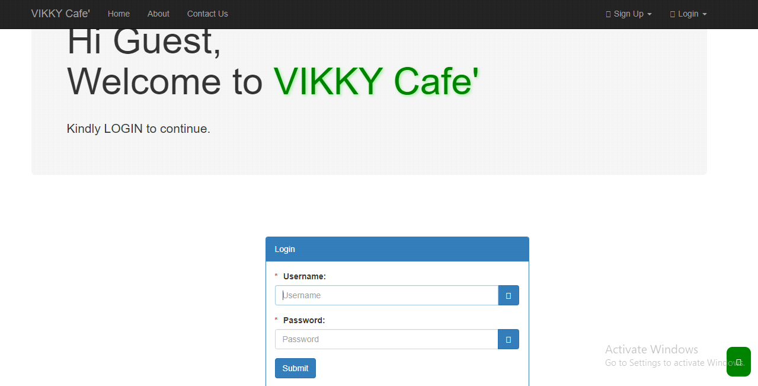

Slide 12
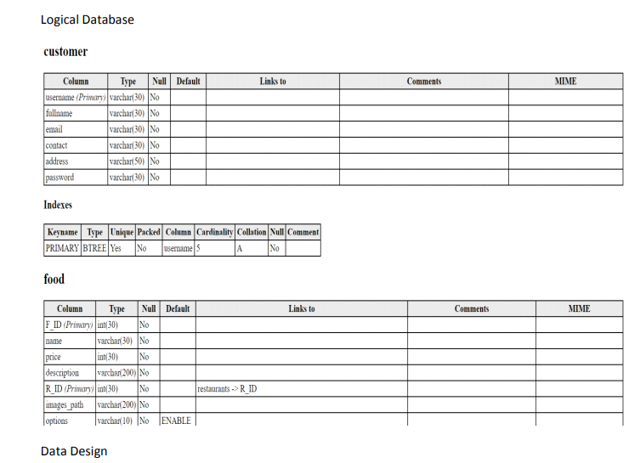

Slide 13
TESTING
In the test generation all the phases are tested to ensure that there are no errors , if there are
some errors , it is removed and fixed.

Slide 14
SOTWARE PROJECT MANAGEMENT COST:GH¢250

